Slide 1
ASSET TRACKING MANAGEMENT SOFTWARE

Slide 2
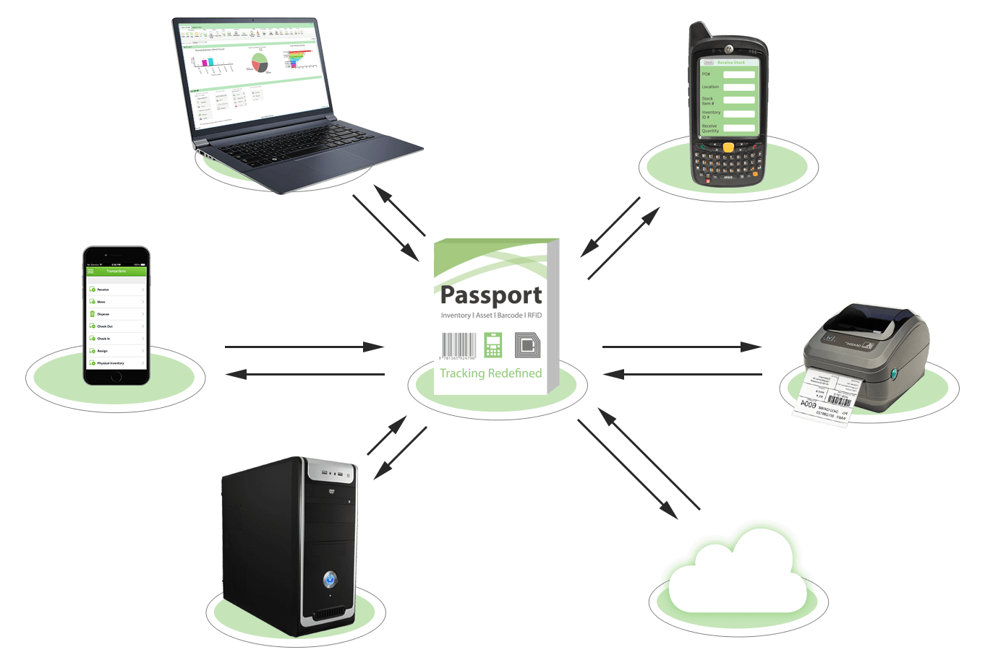
WHAT IS ASSET TRACKING SOFTWARE Asset tracking allows you to track your assets any time RFID allows you to track and verify your assets very fast RFID also helps decrementing theft ,prevention and detection Assets verification can be done very fast

Slide 3
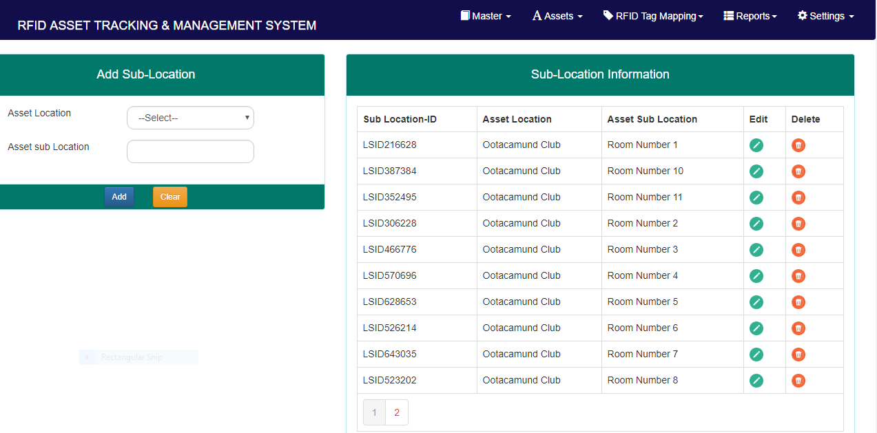
MASTER LOCATION & SUB LOCATIONS Add N number of locations as per your needs Each location can have N number of sublocations Each location and sublocation can be identified by RFID tags

Slide 4
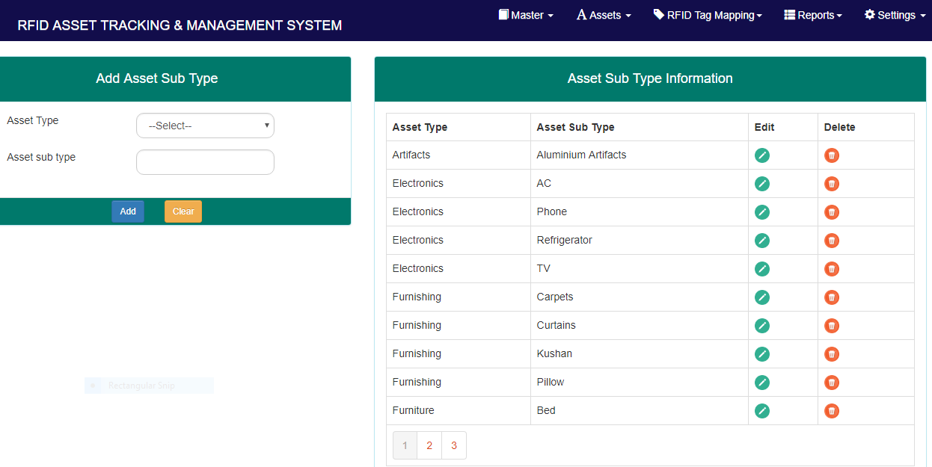
ASSET TYPE & SUB TYPE We can classify asset as per our requirements These asset classification can be further broken into subcategories

Slide 5
ASSET REGISTRATION All your individual assets as per their sub locations can be added to the asset register. Assets can have child property and quantity defined. Each assets have a provision of storing up to three images Asset details such as manufacturer details, warranty ,size ,color etc can be defined The complete assets are displayed in tabular form

Slide 6
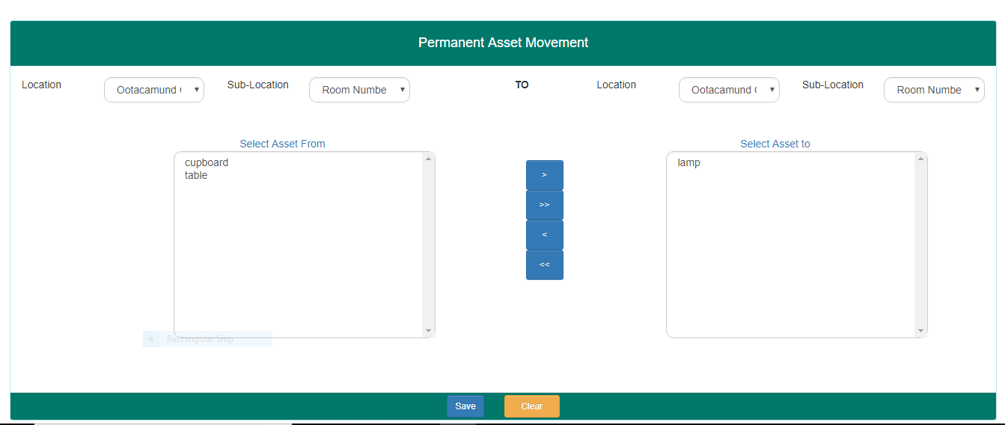
ASSET MOVEMENT Assets can be moved from one sublocation to another sub location Likewise assets can be moved across location The transfer is peramanent. On verification the assets will be so at the new location

Slide 7
ASSET VERIFICATION Asset can be verified as per their sub location using HandHeld device It will also show mismatch asset in the sublocation ASSET IMPORT Assets can be imported in bulk In to the database corresponding Images can also be uploaded at one shot .

Slide 8
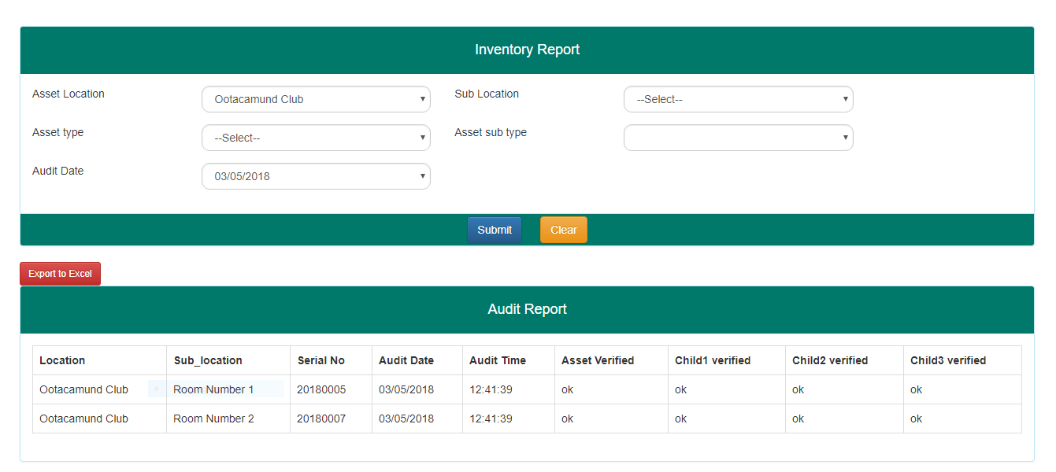
REPORT Master Report Master report shows the complete list of assets in the particular location Verification Report The Verification report shows the assets which have been verified using the HandHeld device Further report can be provided as per client requirement

Slide 9
#16,13th Cross, Vasanth Nagar East, Bangalore - 560052. Karnataka INDIA. Tel: +91 - 80 - 2225 6392

